Slide 1
ROAD MAP DREAM ROLE
to.
Dream big, it’s the first step to success, making goals come second.

Slide 2




Dream Job
Full stack developer
Network security Engineer
It's very relaxing when I complete the application. It is an app development that keeps me working all day and night.
Security isn't something you buy, it's something you do, and it takes talented people to do it right
Project Manager
UI/UX Designer
Good management consists in showing average people how to do the work of superior people. And I have that skill.
Design is everywhere. From the dress you’re wearing to the smartphone you’re holding, it’s design.

Slide 3
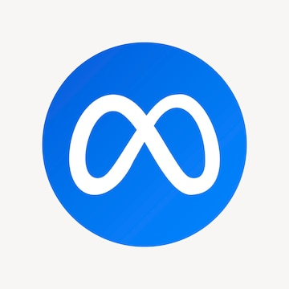



Product Base Company
Meta
Microsoft
Amazon
Google
Meta is the parent company of Facebook, Instagram, WhatsApp, and many more. So they work with networking where security is important for users. And in this company, I want to be a network engineer.
Microsoft is a company that provides a good UI/UX interface first time in operating system. It helps a nontechnical person use computers easily. I want to be a UI/UX designer in this company.
Cloud Computing is the most important part of web services In this era. Google work on services like Colab, Drive, etc. I want to know more about cloud computing. I want to be part of google as a Cloud engineer.
Amazon values customer obsession I believe that customer first leads to better products and software to maintain this obsession project managers are the most responsible person that’s why I want to be a project manager at Amazon.

Slide 4
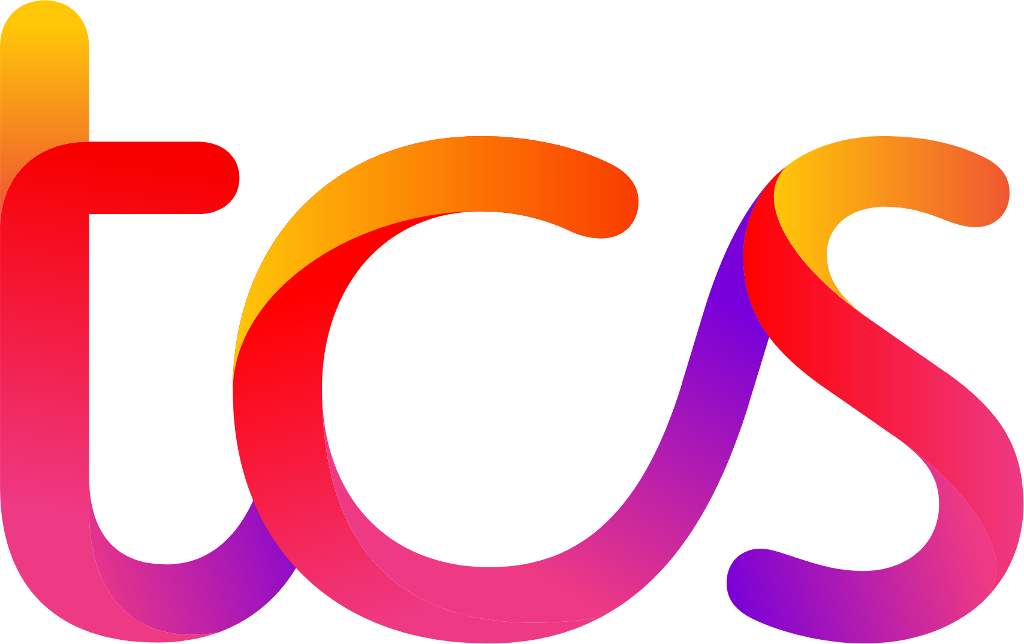
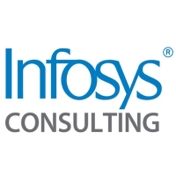


Service Base Company
TCS
Infosys
Wipro
Tech Mahindra Limited
TCS is not only the largest IT service-based company in India but, is counted among one of the most distinct technology-centric companies worldwide. It is a great opportunity to work for TCS and I like the project manager role in this company.
Wipro Limited is presently the fourth-largest Indian multinational company that provides IT solutions, consulting, and business process services to clients worldwide. They provide Cloud Services so, I want to be a cloud engineer in this company
It is the first company from India that got listed on the, known for its exceptional IT and consulting services. Infosys provides Cyber Security services and I like Network Security Engineer role in this company.
The company has established its brand by servicing innovative and efficient IT and business outsourcing services with its customer-centric approach, latest technology, reusable assets, and innovative platforms. like to be a Network Security Engineer
In this company.

Slide 5
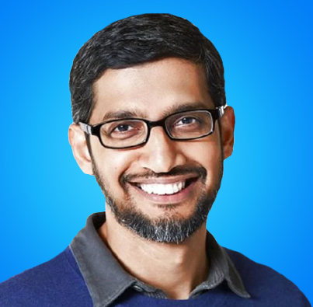
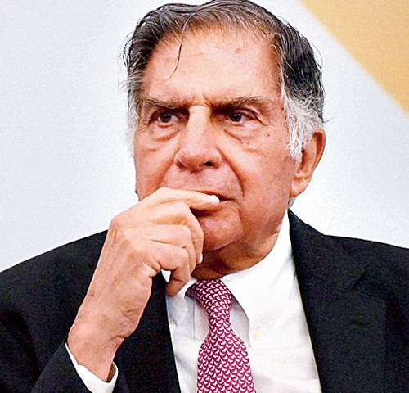

Role Model
Sundar Pichai Sundar Pichai is the CEO of Google and Alphabet. He led the development of the Google Toolbar and Google Chrome.
Sir Ratan Tata
Ratan N Tata, Chairman Emeritus, was the Executive Chairman of Tata Sons, one of the two promoter-holding companies of the Tata group
Warren Buffett Warren Edward Buffett is an American business magnate, investor, and philanthropist. He is currently the chairman and CEO of Berkshire Hathaway. He is one of the most successful investors in the world

Slide 6





Connection establishment with company
Google
Wipro
Amazon
Infosys
Microsoft
TCS
Meta
Tech Mahindra Limited

Slide 7

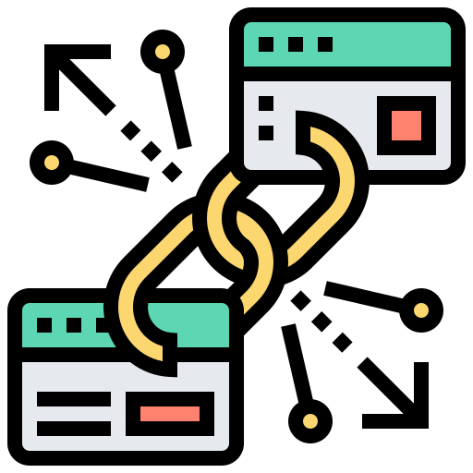




Technologies
Cloud Computing
Blockchain
The cloud offers businesses more flexibility overall versus hosting on a local server.
It can provide secure transactions, reduce compliance costs, and speed up data transfer processing.
Metaverse
Cyber Security
The Metaverse is not only an emerging new technology hype cycle. that's part of today's
With cyber security, companies have peace of mind that unauthorized access to their network or data is protected
Digital Trust
IoT
Digital Trust is a foolproof way to make sure that your clients feel safe giving their business to your company.
The internet of things helps people live and work smarter, as well as gain complete control over their lives.

Slide 8
Certification / Internships I have planned
In this course I will learn both front and back-end development, becoming a full-stack developer.
Web Development
In this Learn UI/UX best practices using the latest trends in the industry
UX/UI Design
Front-End Development by META
In this course, I get an opportunity to take classes from meta and learn about front-end development
Not yet taken any course but I want to learn more about Cloud Computing
Cloud Computing

Slide 9
Projects I have planned
Landing Page
Algo Trading Bot
I planned a project which is a landing page about me where I showcase my web developer skills. In UI/UX design field design is the main showcase so it is a good way to express to interviewer how I manage the UI/UX
In this era, Indians are more focused on trading and making money to invest their money in stocks. So I planned that make one algo trading bot it help investors to Reduce transaction costs. Simultaneous automated checks on multiple market conditions. Reduced risk of manual errors when placing trades. The bot Fully Rely on historical data. And push some flags to the investor when a good opportunity came.

Slide 10
Gantt Chart for Road Map
 | 2022 | 2023 |  |  | 2023 | 2024
Tasks | Q3 | Q1 | Q2 | Q3 | Q4 | Q1 | Q2 | Q3 | Q4
Certifications
Register for placements
Web development classes
Completed the projects
Knowledge about DSA
Internships
Attempting interview
Job
Changing company
ONGOING
COMPLETED
ONGOING
NOT STARTED YET
DUE
NOT STARTED YET
ONGOING
NOT STARTED YET
NOT STARTED YET

